Slide 1
Class 2 - Transitional Internet Basics
Notes:
30-44 30 minutes Our next session will focus on your use of the Internet as a resource to support your child in learning.

Slide 2
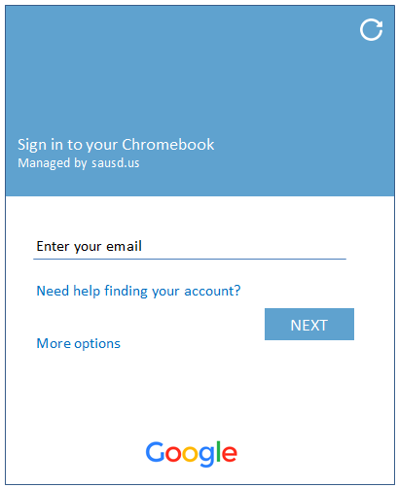
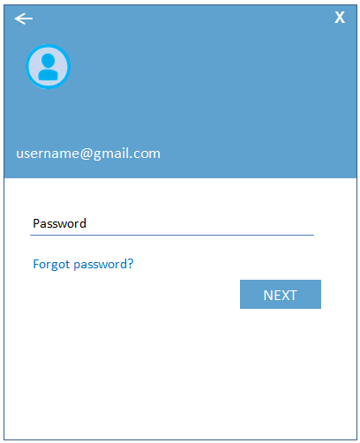
Log into the Chromebook
using the test account provided
Enter your Gmail username & Password provided on your handout.
Enter Gmail Username
& select Next
Enter Password
& select Next
Enter your Gmail
Username Only
Enter your Password
Notes:
Here is where we will have parents turn on the chromebook and now login. This screen is only for the day of the Digital Citizenship Academy. Parents will log in using the test student accounts provided.

Slide 3
Internet Basics

Slide 4
Screen After Logging In
Click in the lower left corner on Google Chrome
Notes:
Have the users hover mouse cursor over Google Chrome, Gmail, Google Docs, Youtube – don’t click!
Have users go back to Google and click

Slide 5
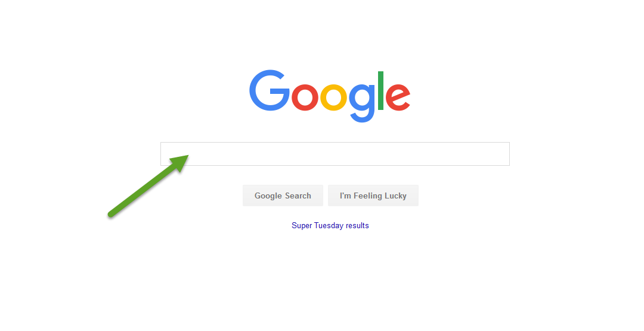
vs. Google Search
The Address bar
Notes:
Explain how they can search for anything by typing in the Google search field. Even a question can be typed into search. The address bar is used to type a url (for example: www.sausd.us)
Most popular top level domains? .com, .org, .net
Have them type in Sausd.us to go to the district webpage for the next slide

Slide 6
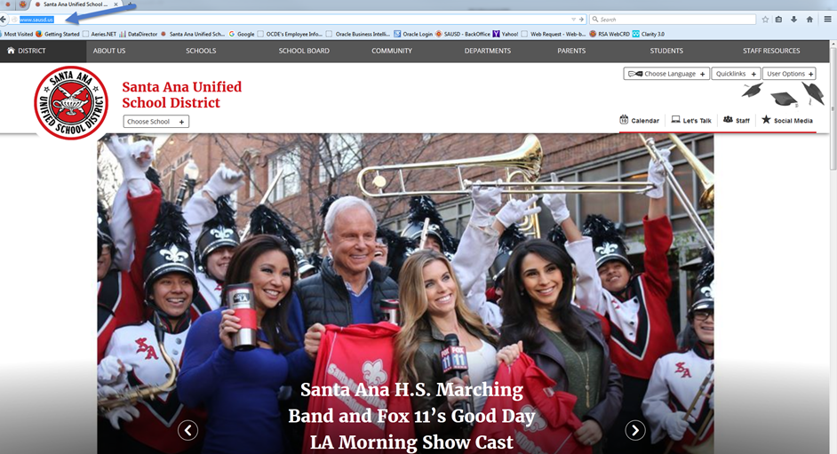
Let’s practice…with SAUSD resources
Online Resources for You and Your Family
Type www.sausd.us in the address bar (top left corner of your page)
Then click Enter on your keyboard after you have typed in the website address. This is the main webpage for all of the Santa Ana Unified School District.

Slide 7
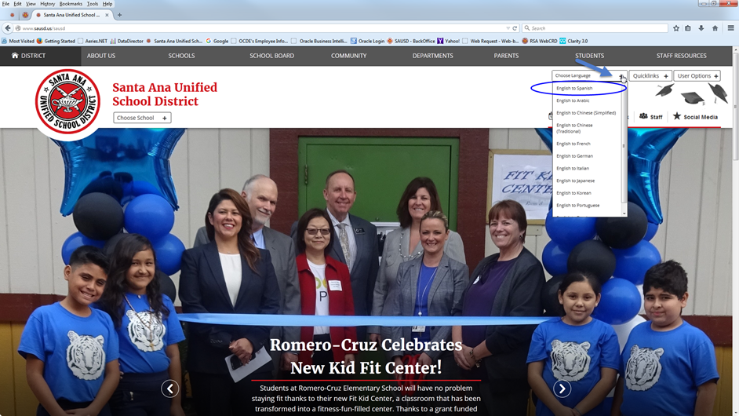
Choose Language preferences
Click on “Choose Language” in the top right corner of the page.
Select and click “English to Spanish”

Slide 8
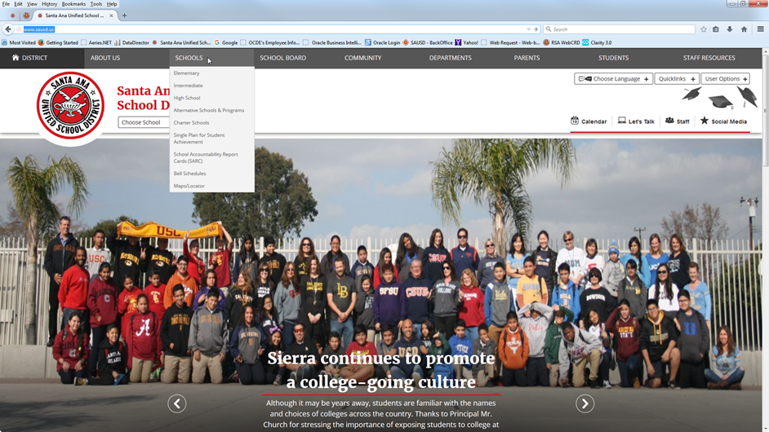
Find your child’s school webpage
Click on SCHOOLS

Slide 9
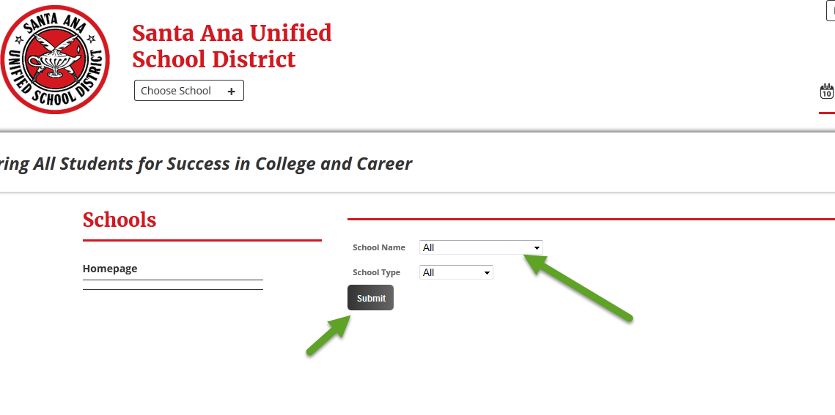
Find the name of your school
Click on the triangle to open the list of school names.
Click on the name of your child’s school.
The schools are listed in alphabetical order.
Click the button once you have found the name of the school.
Submit

Slide 10
Learn about your child’s school
Let’s have a Scavenger Hunt...
Find the following 4 items on the school’s webpage:
What is the name of the school’s principal?
What is the phone # of the school?
Where is the school calendar?
What is one current event happening at the school?

Slide 11
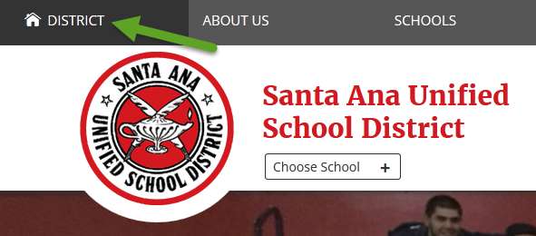
Return to the SAUSD District webpage
Click on District in the top left corner.
2. Once you are on the District’s main webpage, click on Parents in the top right corner.
Notes:
Remind parents to click in the top left corner on District then on Parent.

Slide 12
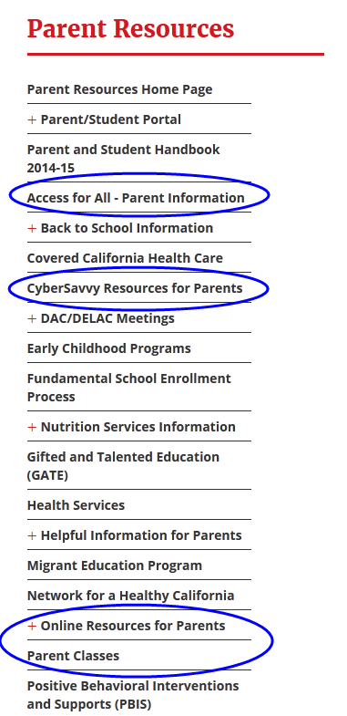
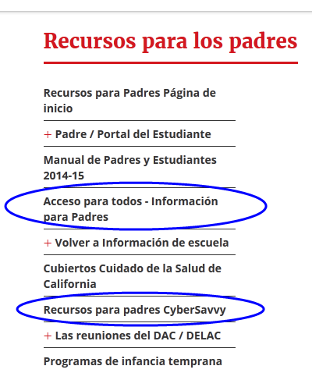
SAUSD Parent Resources
http://www.sausd.us/domain/12
Notes:
point out the cyber savvy link and the parent internet resources page

Slide 13
Internet Identity,
Safety, & Security
The world is at your fingertips.
Notes:
slides 45 -

Slide 14
Understanding URLs
.com (.commercial -for most businesses)
.net (.network)
.edu (for education)
.org (for non-profit organizations)
Notes:
You learned about URLs in How to Use a Browser. What is a URL? Uniform Resource Identifier. More commonly called a web address.
Most popular top level domains? .com, .org, .net

Slide 15
Opening Up the Digital World
shopping
information
entertainment
banking
education

Slide 16
Staying Safe Online
Protect Your Family from Online Identity Theft*
*Someone uses your personal information without your knowledge to commit fraud or theft.
Prevention Tips:
Create strong passwords and use different passwords for different sites - keep them private.
When creating passwords, don't use information that could be easily linked to you (like your birth date, Social Security number, phone number, or the names of pets or hobbies).
Don't reply to e-mail or pop-up messages that requests you update or provide personal information.
Remind your children not to give private information online.

Slide 17
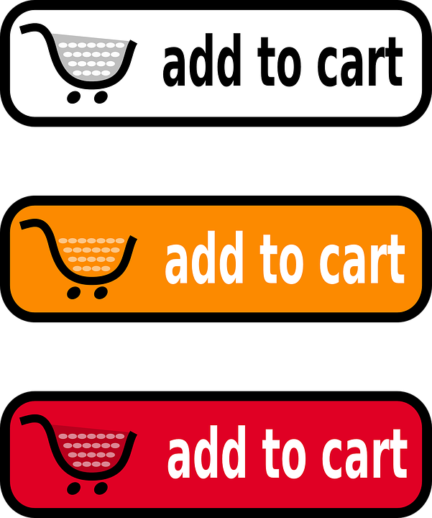
Safe Online Shopping
Type web addresses carefully and only use secure, known sites to shop.
https : the “s” means a secure site.
Never give anyone your credit card information over email.
Protect your personal information.
Online stores don’t need your social security number or your birthday.
Choose one credit card or a prepaid credit card for online use only.
Notes:
are any of you shopping online? we are in no way promoting that you shop online!

Slide 18
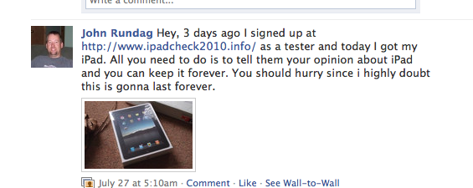
How Viruses & Spyware Spread
User clicks on link in an email, email attachment, or downloadable file on a website or on a social network. The link takes user to a website that attacks browser and forces virus or spyware
Prevention Tip: Don’t click on suspicious links, pop ups, or ads offering you anything for free, even if it looks like it comes from a friend.
fREE IPAD!!!!
Notes:
Have you heard the phrase there’s no such thing as a free lunch? Well, there’s also no such thing as a free iPad. Mention that Chromebooks are more secure than a PC or laptop but that it’s important to understand how easy it is to inadvertently click on something malicious.
Have you ever received a similar message? Maybe through email?
Email and networking profiles get hijacked.

Slide 19
Your Digital Footprint
Dos Tipos de Estúpido
Two Kinds of Stupid
Maintaining a positive online reputation is emphasized by SAUSD. It is important since it can affect students’ college and career opportunities.
The video above is an example of teaching materials used in our classrooms.
Notes:
Click the hyperlink to show the video (3:03 minutes). Screen will open in Netsmartz - expand to full screen.

Slide 20
Protect Your Online Identity
Potential employers often look at Facebook pages.
Private information is no longer, by default, private. If you want information to be private, you must take steps to make it so.
Digital content is easily forwarded and re-posted.
Your online reputation has offline implications.
Notes:
A

Slide 21
Digital resources for parents
Notes:
slides 45 -

Slide 22
Additional Resources
How Computer Viruses Work
Como los virus informáticos Trabajo
How Spyware Works
Cómo funciona el software espía
Common Sense Media (English and Spanish)
Netsmartz for Parents (English and Spanish)
YouTube (Google Help)

Slide 23
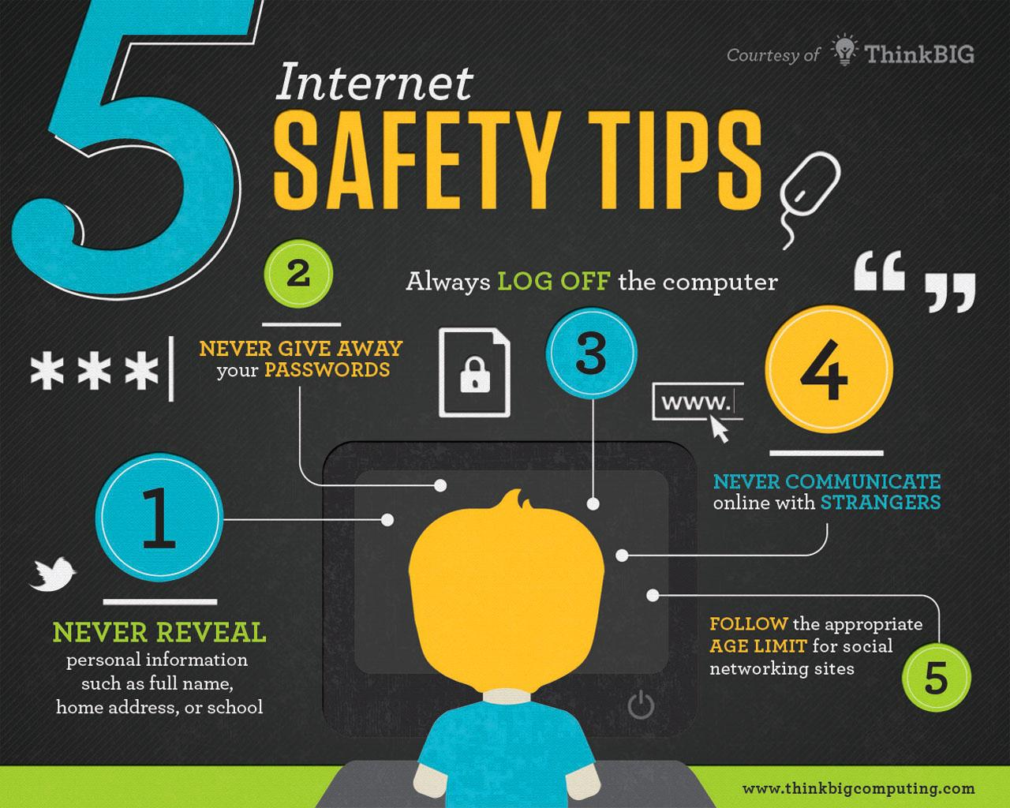

Slide 24
Questions and Answers

Slide 25
Notes:
End of class 2.. Ask if there are any questions or comments.

